Slide 1
source: Liszkowski et al (2008)

Slide 2
source: Liszkowski et al (2008)

Slide 3
source: Liszkowski et al (2008)

Slide 4
source: Liszkowski et al (2008)

Slide 5

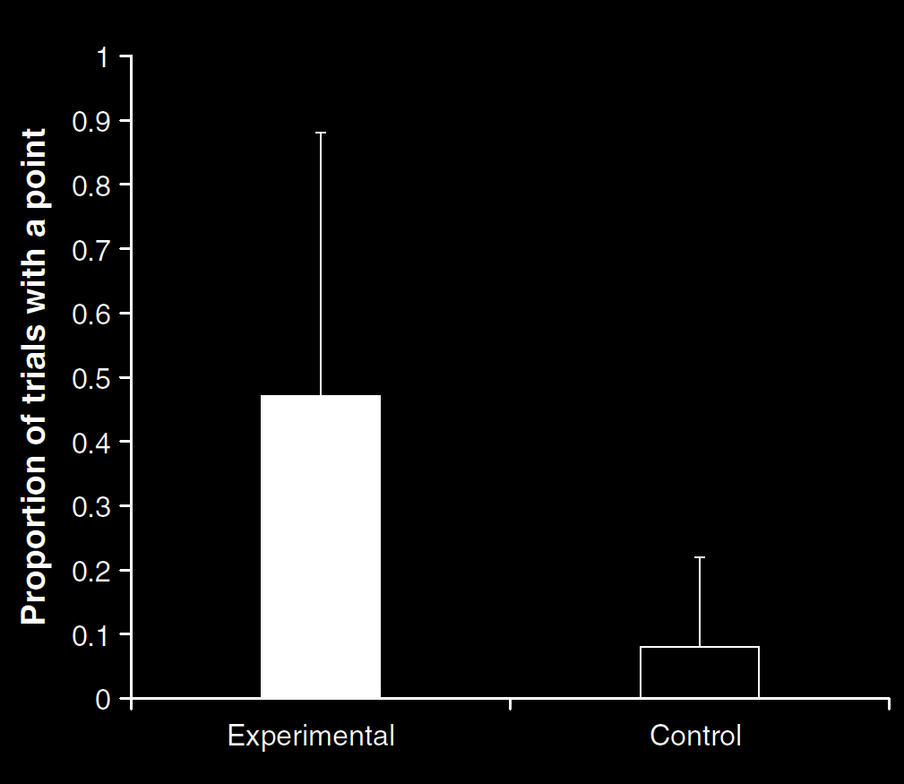
Your field = a set of objects related to you by proximity, orientation, lighting and other factors
You encounter an object = it is in your field
You register an object at a location = you most recently encountered the object at that location
Principle 1: one can’t goal-directedly act on an object unless one has encountered it.
Principle 2: correct registration is a condition of successful action.
Principle 3: when an agent performs a goal-directed action and the goal specifies an object, the agent will act as if the object were actually in the location she registers it at.
source: Liszkowski et al (2008)
proximity
orientation
lighting
barriers
trajectory

Slide 6
Your field = a set of objects related to you by proximity, orientation, lighting and other factors
You encounter an object = it is in your field
You register an object at a location = you most recently encountered the object at that location
Principle 1: one can’t goal-directedly act on an object unless one has encountered it.
Principle 2: correct registration is a condition of successful action.
Principle 3: when an agent performs a goal-directed action and the goal specifies an object, the agent will act as if the object were actually in the location she registers it at.
“Helping by informing inextricably involves … an understanding of others’ goals and … of others’ ignorance.”
(Liszkowski, Carpenter & Tomasello 2008: 738-9)
source: Liszkowski et al (2008)
proximity
orientation
lighting
barriers
trajectory

Slide 7
Your field = a set of objects related to you by proximity, orientation, lighting and other factors
You encounter an object = it is in your field
You register an object at a location = you most recently encountered the object at that location
Principle 1: one can’t goal-directedly act on an object unless one has encountered it.
Principle 2: correct registration is a condition of successful action.
Principle 3: when an agent performs a goal-directed action and the goal specifies an object, the agent will act as if the object were actually in the location she registers it at.
“Helping by informing inextricably involves … an understanding of others’ goals and … of others’ ignorance.”
(Liszkowski, Carpenter & Tomasello 2008: 738-9)
“Helping by informing inextricably involves … an understanding of others’ goals and … of others’ ignorance.”
(Liszkowski, Carpenter & Tomasello 2008: 738-9)
source: Liszkowski et al (2008)
proximity
orientation
lighting
barriers
trajectory

